Slide 1
70-533 : Implementing Microsoft Azure Infrastructure Solutions

Slide 2
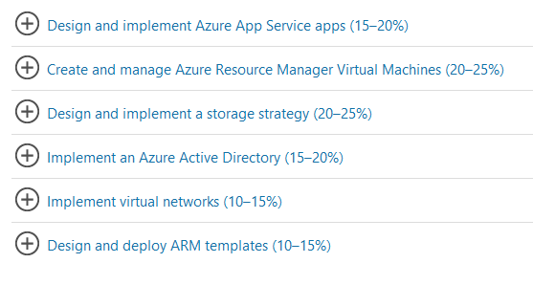
70-533 : Implementing Microsoft Azure Infrastructure Solutions

Slide 3
What is Azure Active Directory?
Azure Active Directory (Azure AD) is Microsoft’s multi-tenant cloud based directory and identity management service.
For IT Admins, Azure AD provides an affordable, easy to use solution to give employees and business partners single sign-on (SSO) access to thousands of cloud SaaS Applications like Office365, Salesforce.com, DropBox, and Concur.
Azure AD also includes a full suite of identity management capabilities including multi-factor authentication, device registration, self-service password management, self-service group management, privileged account management, role based access control, application usage monitoring, rich auditing and security monitoring and alerting. These capabilities can help secure cloud based applications, streamline IT processes, cut costs and help ensure that corporate compliance goals are met.
AD can be integrated with an existing Windows Server Active Directory, giving organizations the ability to leverage their existing on-premises identity investments to manage access to cloud based SaaS applications.
If you are an Office365, Azure or Dynamics CRM Online customer, you might not realize that you are already using Azure AD. Every Office365, Azure and Dynamics CRM tenant is actually already an Azure AD tenant. Whenever you want you can start using that tenant to manage access to thousands of other cloud applications Azure AD integrates with!

Slide 4
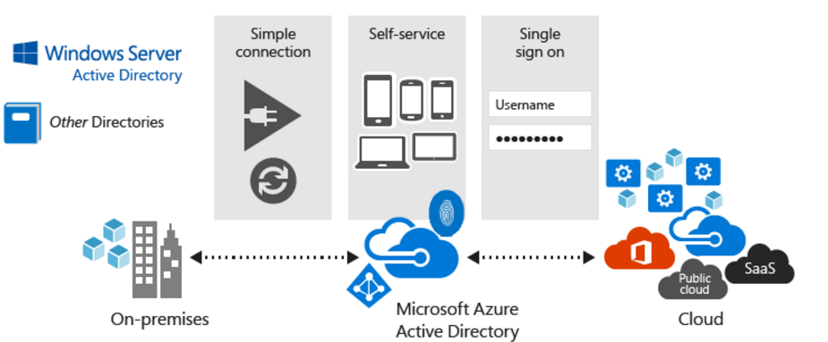
Quickly adopt cloud services, providing employees and partners with an easy single-sign on experience powered by Azure AD’s fully automated SaaS app access management and provisioning services capabilities.
Empower employees with access to world class cloud apps and self-service capabilities from wherever they need to work on the devices they love to use.

Slide 5
Integrate an Azure with Existing Directory

Slide 6
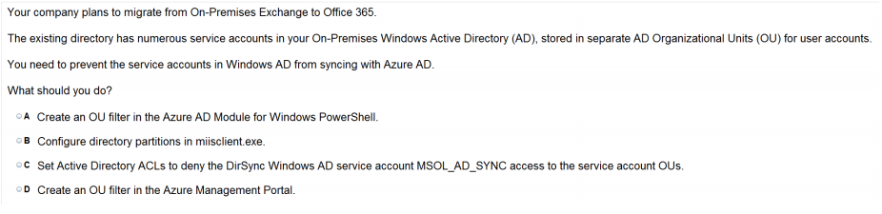
Ans = B
A service account is a special user account that an application or service uses to interact with the operating system. Services use the service accounts to log on and make changes to the operating system or the configuration. Through permissions, you can control the actions that the service can perform. The following table identifies categories of service accounts.
Miisclient is known as "Synchronization Service Manger on Dirsync" . In this type of filtering we can filter individual user objects from being synced to the cloud.
MANUALLY RUN DIRSYNC VIA THE MIIS CLIENT
One customer, who was looking for OU level filtering to import selected users from OnPremises active directory toOffice365.Configure OU level filtering for Office365 directory synchronization.

Slide 7
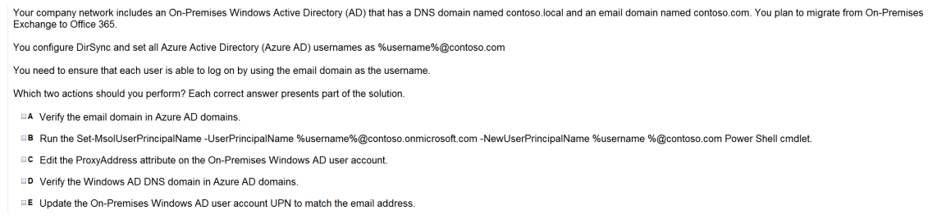
Ans = A & B
The Set-MsolUserPrincipalName cmdlet changes the User Principal Name, or user ID, of a user. This cmdlet can be used to move a user between a federated and standard domain, which results in their authentication type changing to that of the target domain.

Slide 8
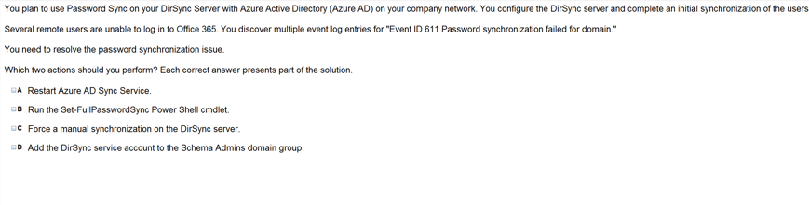
Ans = A & B
DirSync (Windows Azure Active Directory Sync)
After that, DirSync runs every three hours to push changes from the on-premises directory to the cloud instance. DirSync only goes from on-premises to cloud. If an administrator were to create a new user on the Windows Azure Active Directory tenant, that user would live only in the cloud and would never be propagated down to the on-premises directory.
https://support.microsoft.com/en-us/help/2915221/passwords-don-t-sync-for-users-who-are-moved-into-scope-to-be-synced-in-the-azure-active-directory-sync-tool

Slide 9
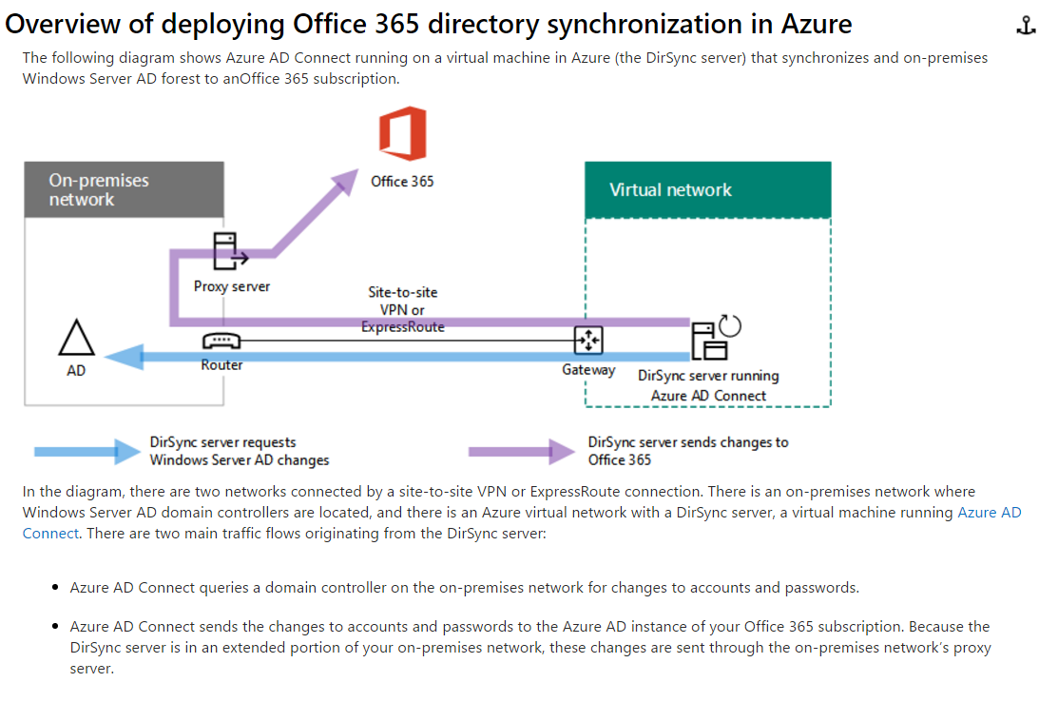

Slide 10
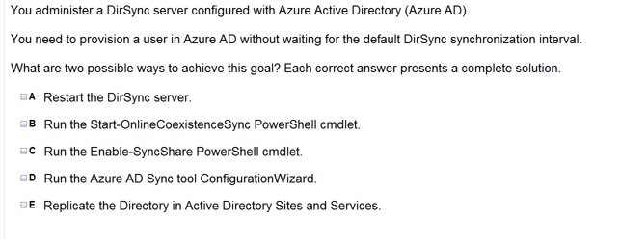
Ans =B & D
In order to force a sync, we first had launch a Windows Powershell 2.0 console on the respective server and then navigate to “C:\Program Files\Microsoft Online Directory Sync” or “C:\Program Files\Windows Azure Directory Sync” folder (depending on version in use) and from here run the “DirSyncConfigshell.psc1” script followed by running the actual “Start-OnlineCoexistenceSync” cmdlet that initiates the sync itself.
http://techgenix.com/dirsync-change-forcingmanual-syncs/

Slide 11
Explanation: If you don’t want to wait for the recurring synchronizations that occur every three hours, you can force directory synchronization at any time.
B: Force directory synchronization using Windows PowerShell You can use the directory synchronization Windows PowerShell cmdlet to force synchronization. The cmdlet is installed when you install the Directory Sync tool.On the computer that is running the Directory Sync tool, start PowerShell, type Import-Module DirSync, and then press ENTER.TypeStart-OnlineCoexistenceSync, and then press ENTER.
D: Azure Active Directory Sync Services (AAD Sync) In September 2014 the Microsoft Azure AD Sync tool was released. This changed how manual sync requests are issued.To perform a manual update we now use the DirectorySyncClientCmd.exe tool. The Delta and Initial parameters are added to the command to specify the relevant task.This tool is located in: C:\Program Files\Microsoft Azure AD Sync\Bin You can use the directory synchronization Windows PowerShell cmdlet to force synchronization. The cmdlet is installed when you install the Directory Sync tool.On the computer that is running the Directory Sync tool, start PowerShell, type Import-Module DirSync, andthen press ENTER.Type Start-OnlineCoexistenceSync, and then press ENTER.

Slide 12
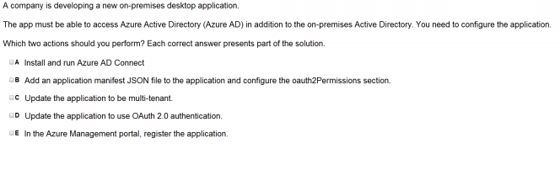
Ans – A & E Video AAD with Office 365 Integration

Slide 13
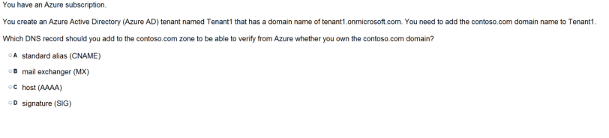
Ans – A What to Explain

Slide 14
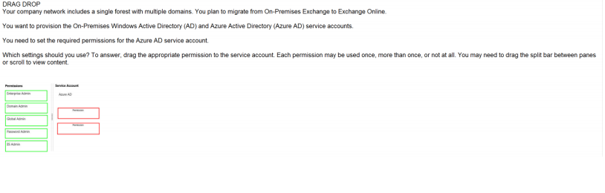
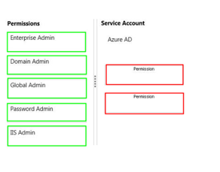
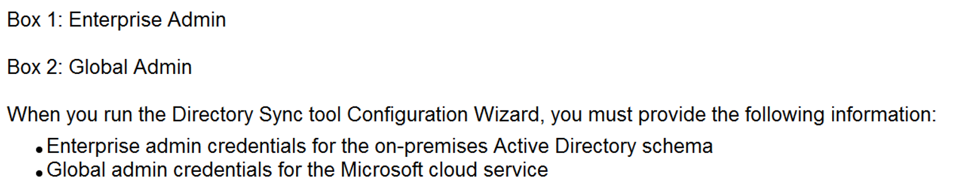
Ans – Enterprise Admin Global Admin

Slide 15
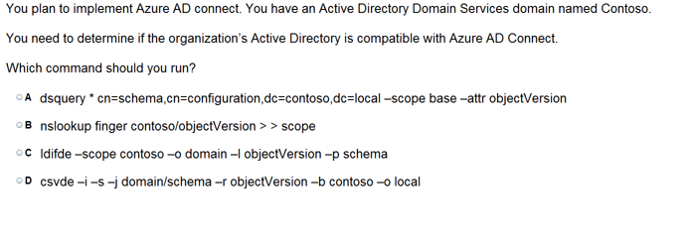
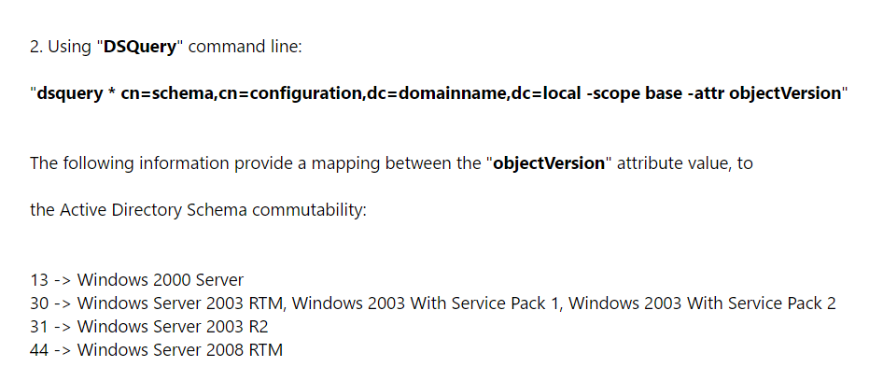
Ans = A
Also used Dsquery in Active Directory server for getting a list of all the machines joined to the domain

Slide 16
Configure the Application Panel

Slide 17
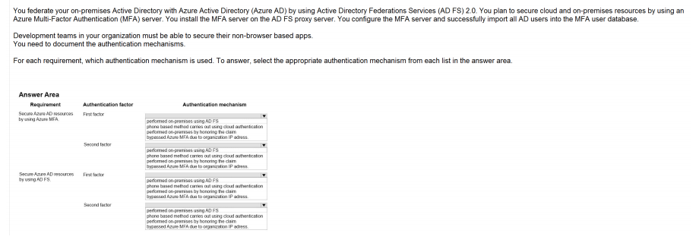
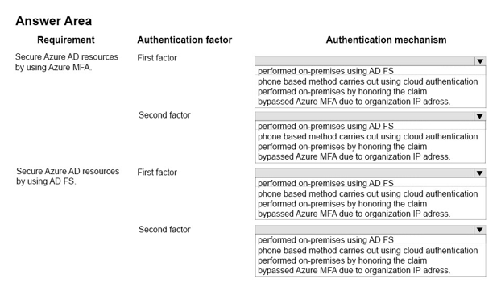
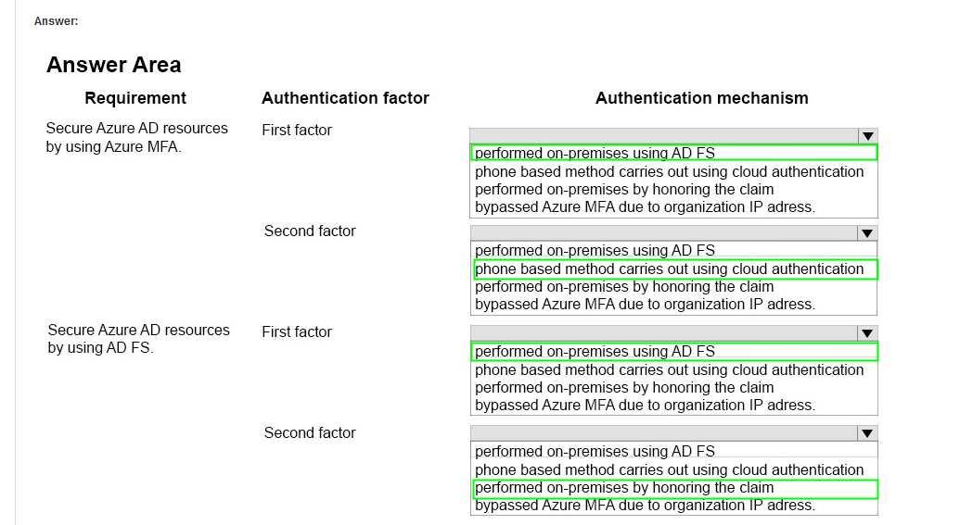
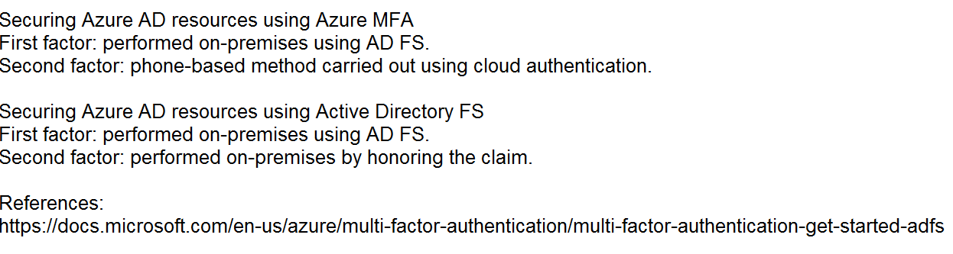
Ans =

Slide 18
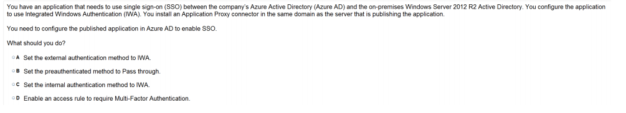
Ans = C You can enable single sign-on to your applications using Integrated Windows Authentication (IWA) by giving Application Proxy Connectors permission in Active Directory to impersonate users, and send and receive tokens on their behalf.

Slide 19
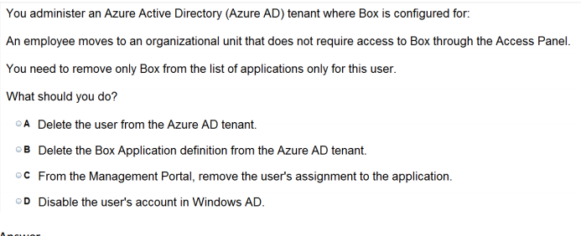
Ans = C
Note: Use Azure AD to manage user access, provision user accounts, and enable single sign-on with Box. Requires an existing Box subscription.

Slide 20
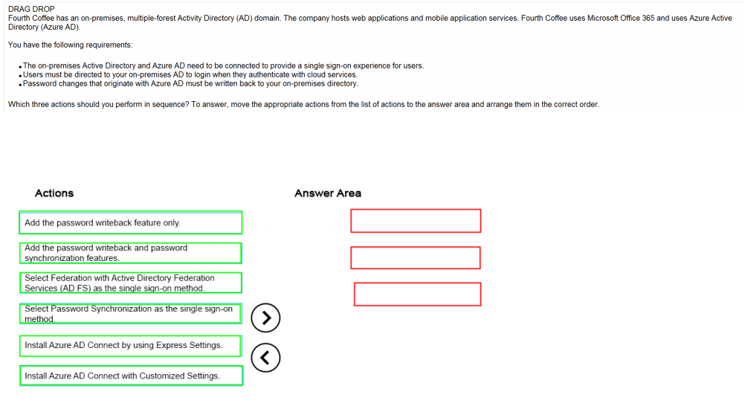
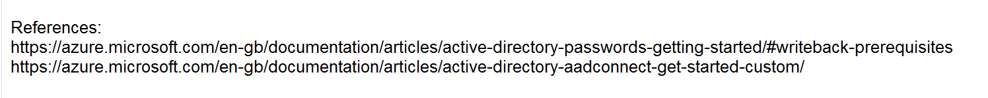
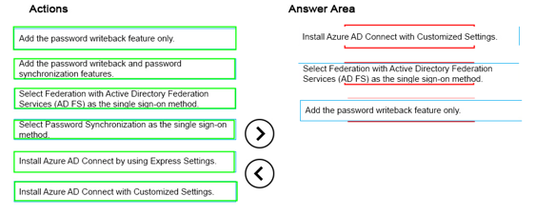
Ans =

Slide 21
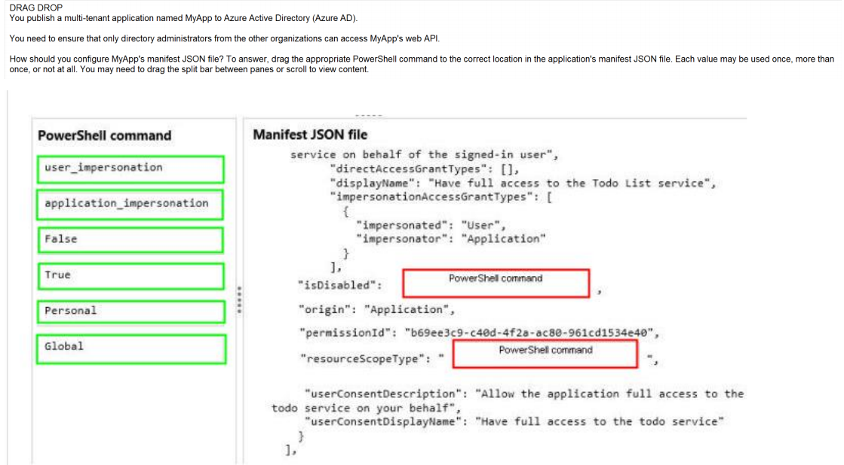
Ans =

Slide 22
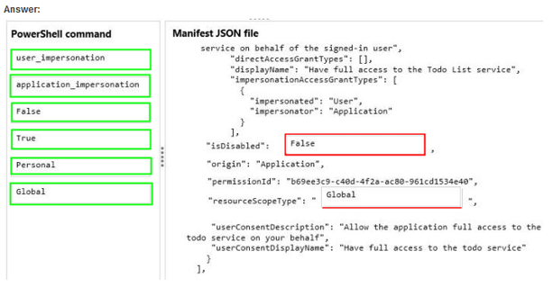

Slide 23
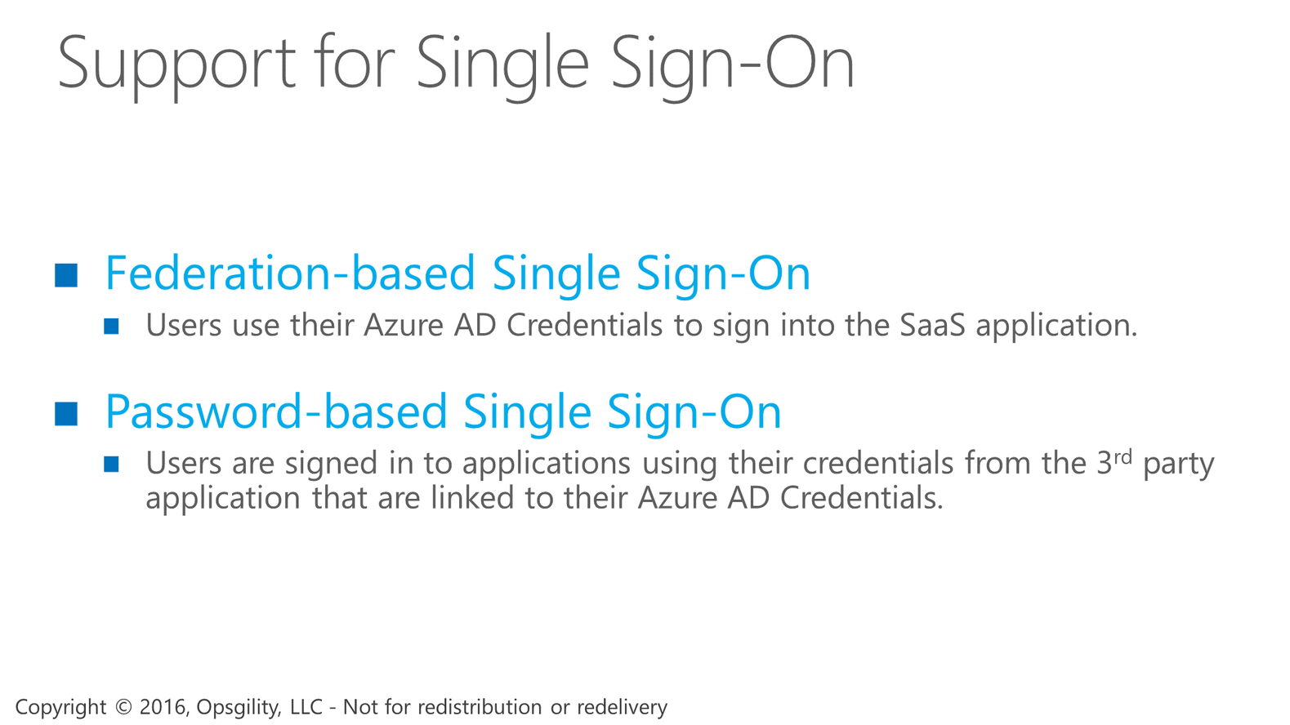

Support for Single Sign-On
Notes:
The support for single sign-on to 3rd party applications comes in two forms.
The first is Federation-based, where users are signed-in to their applications using their Azure AD credentials.
The other is Password-based, where users are signed in to their applications using their own personal credentials from the 3rd party application. In this scenario, the user’s credentials are securely stored in Azure AD and when the user accesses the application, those credentials are provided to the application to sign the user in.

Slide 24
Support for Single Sign-On
Notes:
The support for single sign-on to 3rd party applications comes in two forms.
The first is Federation-based, where users are signed-in to their applications using their Azure AD credentials.
The other is Password-based, where users are signed in to their applications using their own personal credentials from the 3rd party application. In this scenario, the user’s credentials are securely stored in Azure AD and when the user accesses the application, those credentials are provided to the application to sign the user in.

Slide 25
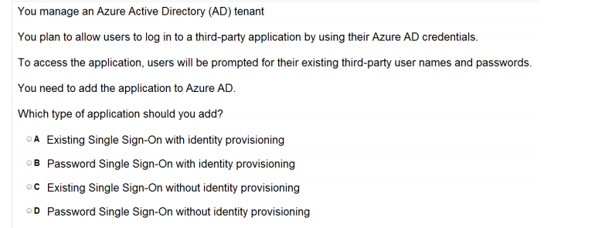
Ans = D
Explanation: * Azure AD supports two different modes for single sign-on: / Federation using standard protocols Configuring Federation-based single sign-on enables the users in your organization to be automatically signed in to a third-party SaaS application by Azure AD using the useraccount information fromAzure AD. / Password-based single sign-on * Support for user provisioning User provisioning enables automated user provisioning and deprovisioning of accounts in thirdparty SaaS applications from within the Azure Management Portal, using your Windows Server Active Directory or Azure AD identity information. When a user is given permissions in Azure AD for one of these applications, an account can be automatically created (provisioned) in the target SaaSapplication.

Slide 26
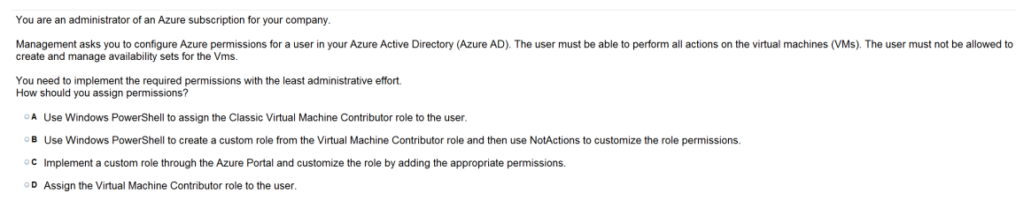
Ans = A

Slide 27
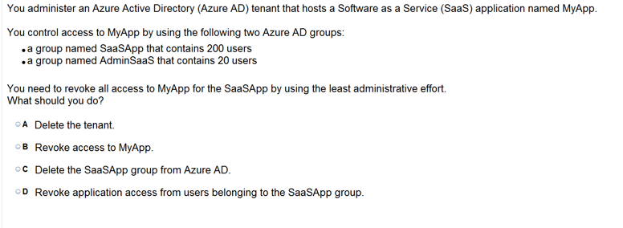
Ans = D

Slide 28
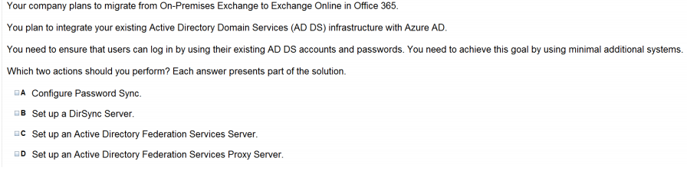
Ans = A & B

Slide 29
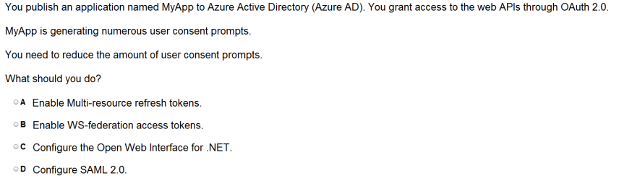
Ans = A
Simply put: a MRRT is a refresh token that can be used to obtain an access token for a resource that can be different from the resource for which the MRRT was obtained in the first place.
When using the AuthorizationCode Grant Flow, you can configure the client to call multiple resources. Typically, this would require a call to the authorization endpoint for each target service. To avoid multiple calls and multiple user consent prompts, and reduce the number of refresh tokens the client needs to cache, Azure Active Directory (Azure AD) has implemented multi-resource refresh tokens. This feature allows you to use a single refresh token to request accesstokens for multiple resources.

Slide 30
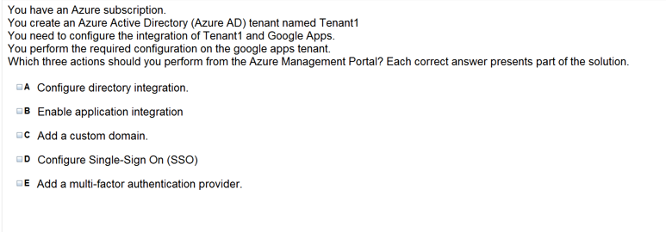
Ans =A & C & D

Slide 31
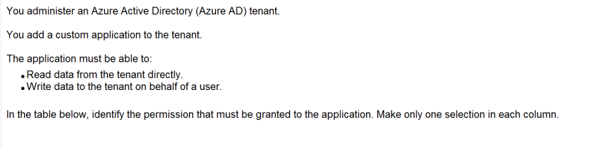
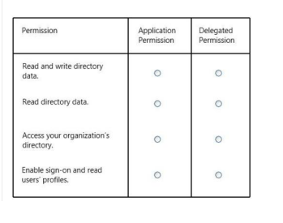
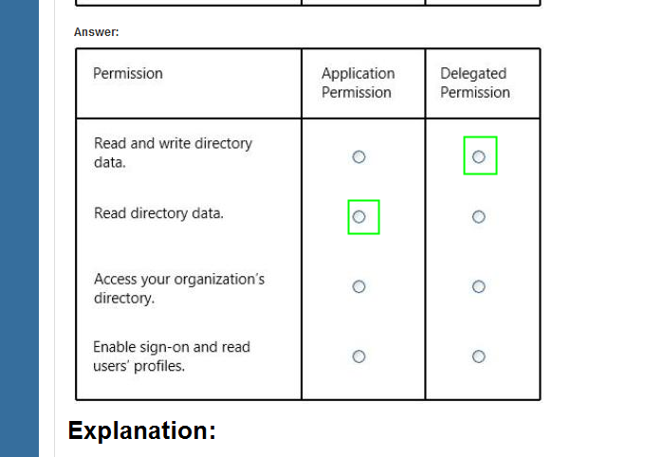
Ans =

Slide 32
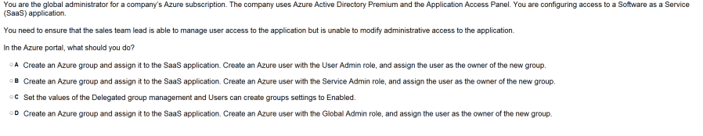
Ans = A

Slide 33
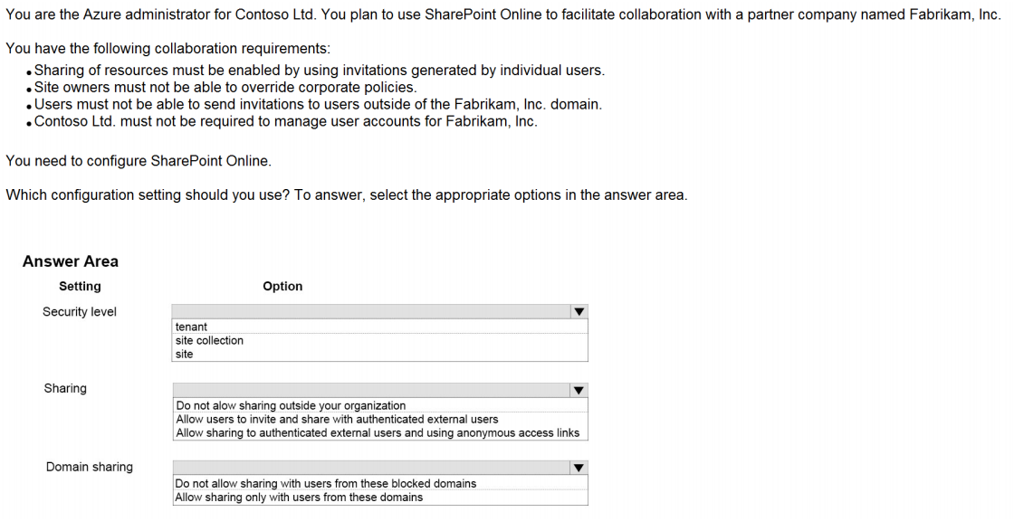
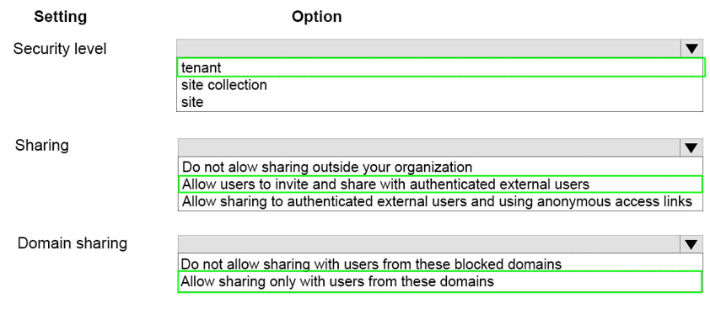
Ans =

Slide 34
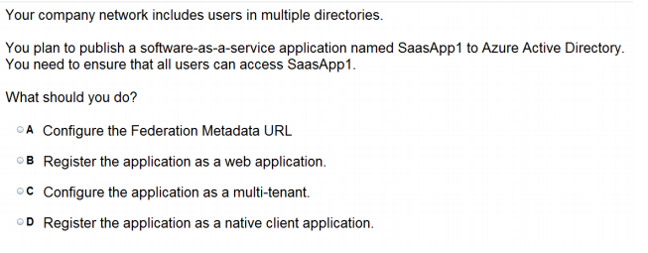
Ans = C The term "software multitenancy" refers to a software architecture in which a single instance of software runs on a server and serves multiple tenants. A tenant is a group of users who share a common access with specific privileges to the software instance
Explanation: * When you get deeper into using Windows Azure Active Directory, you’ll run into new terminology. For instance, is called "directory" is also referred to as a Windows Azure AD Tenant or simply as "tenant." This stems from the fact that WAAD ()Windows Azure Active Directory is a shared service for many clients. In this service, every client gets its own separate space for which the client is the tenant. In the case of WAAD this space is a directory. This might be a little confusing, because you can create multiple directories, in WAAD terminology multiple tenants, even though you are a single client. * Multitenant Applications in Azure A multitenant application is a shared resource that allows separate users, or "tenants," to view the application as though it was their own. A typical scenario that lends itself to a multitenant application is one in which all users of the application may wish to customize the user experience but otherwise have the same basic business requirements. Examples of large multitenant applications are Office365, Outlook.com, and visualstudio.com.

Slide 35
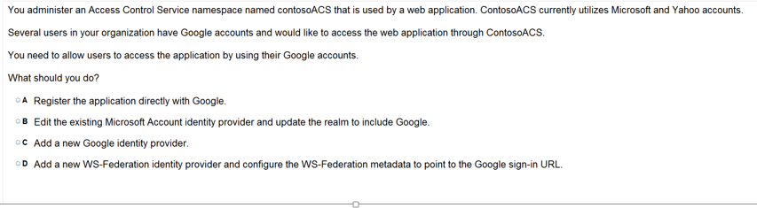
Ans = C
https://docs.microsoft.com/en-us/azure/active-directory/active-directory-saas-google-apps-tutorial

Slide 36
Integrate the App with Azure AD

Slide 37
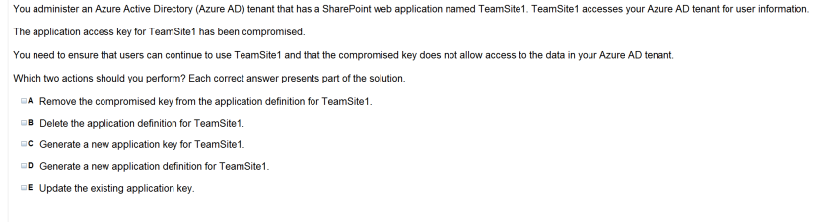
Ans = A & C
One of the security aspects of Windows Azure storage is that all access is protected by access keys.It is possible to change the access keys (e.g. if the keys become compromised), and if changed, we’d need to update the application to have the new key.

Slide 38
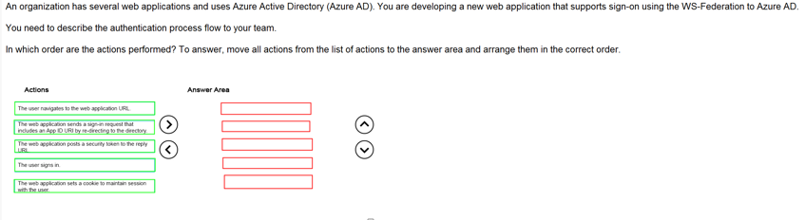
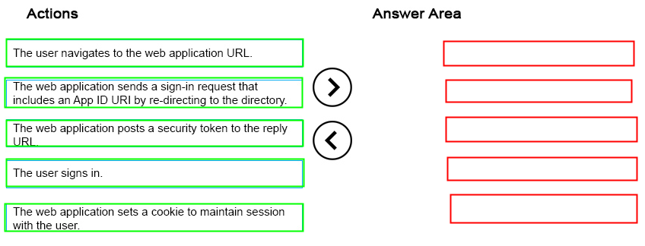
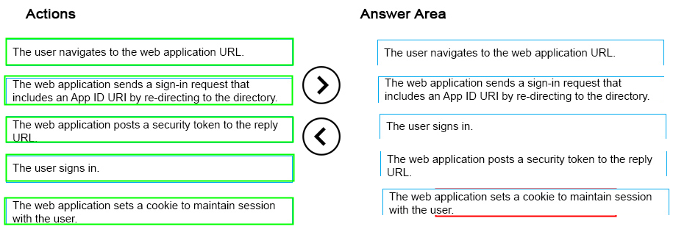
Ans =

Slide 39
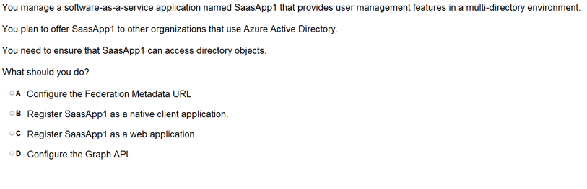
Ans =D The Azure Active Directory Graph API provides programmatic access to Azure Active Directory through REST API endpoints. Apps can use the Azure AD Graph API to perform create, read, update, and delete (CRUD) operations on directory data and directory objects, such as users, groups, and organizational contacts.
REST APIendpoints.Applications can use the Graph API to perform create, read, update, and delete (CRUD) operationson directory data and objects. For example, the Graph API supports the following common operations for a user object: / Create a new user in a directory / Geta user’s detailed properties, such as their groups / Update a user’s properties, such as their location and phone number, or change their password / Check a user’s group membership for role-based access / Disable a user’s account or delete it entirely

Slide 40
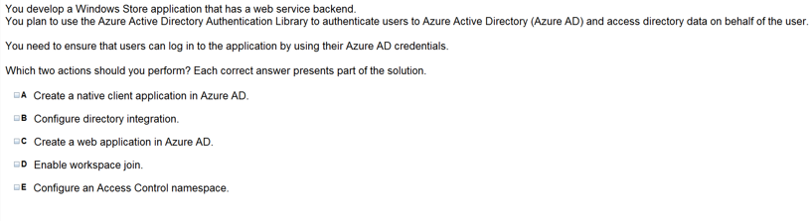
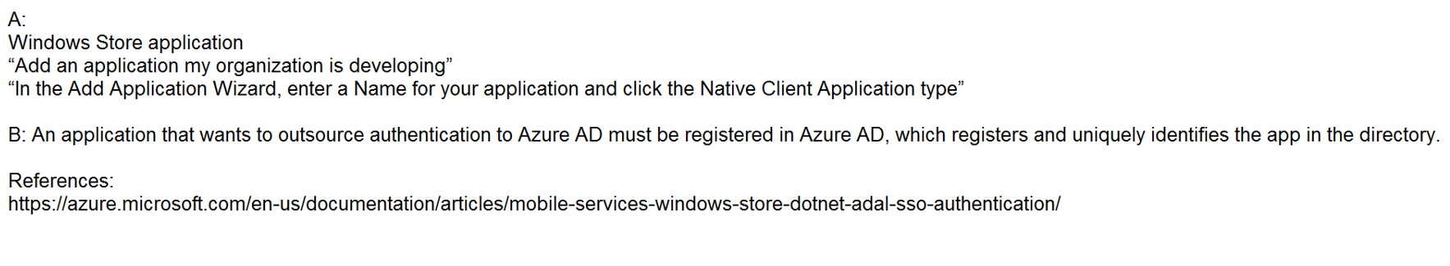
Ans = A & B

Slide 41
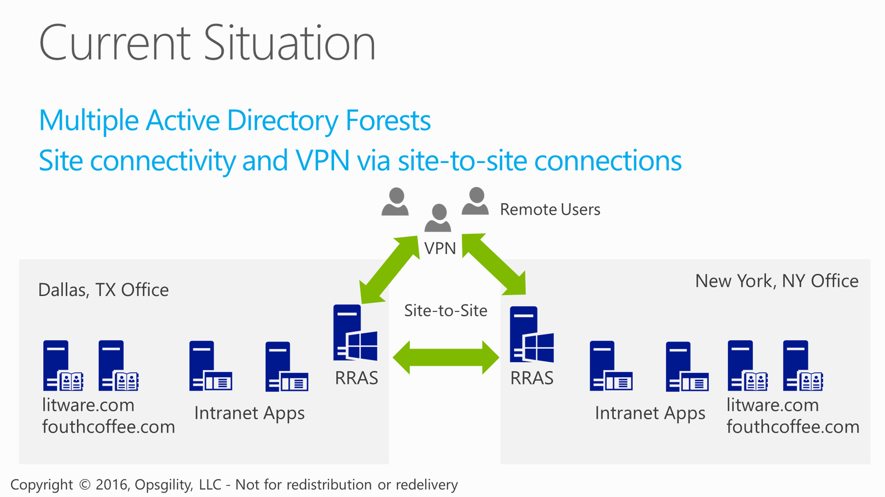
Current Situation

Slide 42
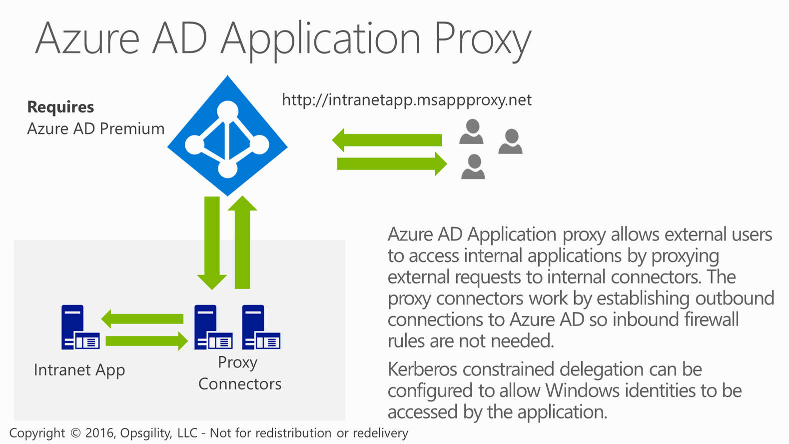
Azure AD Application Proxy

Slide 43
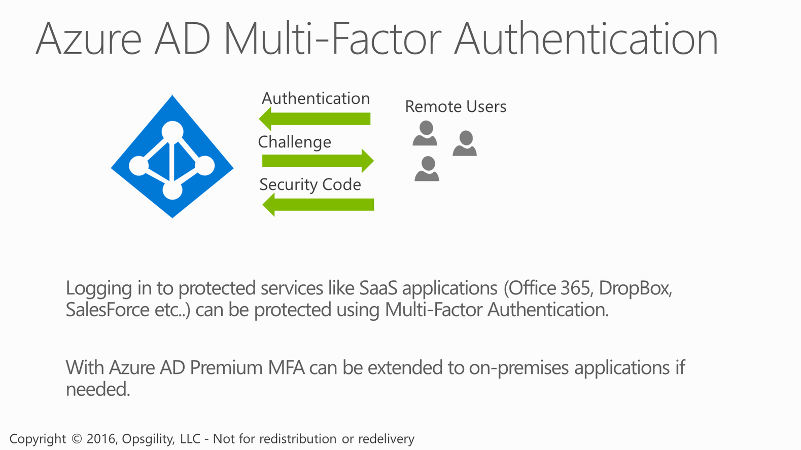
Azure AD Multi-Factor Authentication

